Slide 1
Simulation of bSSFP Pulse Sequence
with Stack-of-Stars K-space Sampling
Group 4
Sharvari Deshmukh, Avanti Bhandarkar, Diana Vucevic
Notes:
Hi, We are group 4 and our project is Simulation of bssfp pulse sequence with stack-of-stars k-space sampling.

Slide 2
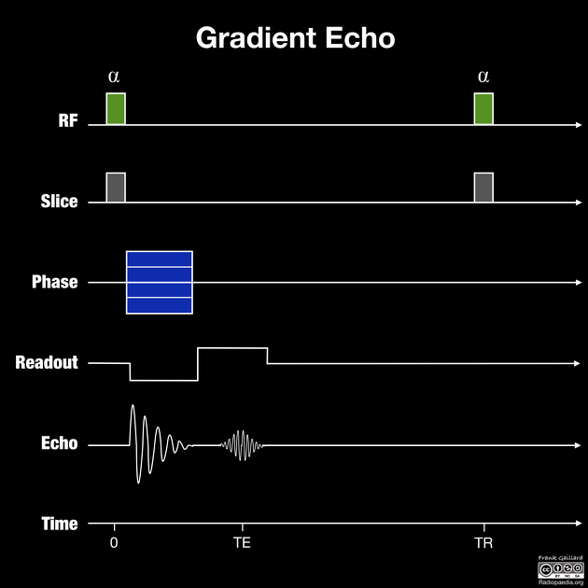
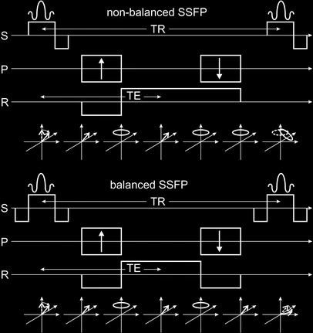
Balanced Steady-State Free Precession (bSSFP): Background
Figure 1. Gradient Echo [a]
Figure 2. SSFP & bSSFP [2]
Notes:
As we all know, MRI uses different pulse sequences to create images for different tasks, like Spin Echo and Gradient Echo.
For gradient echo, there are 2 main types: spoiled gradient echo where the residual transverse magnetization is disrupted, and, steady-state free precession (i.e. SSFP) which maintains the residual transverse magnetization, and allows for a steady-state signal acquisition.
bSSFP is a type of SSFP sequence but with a unique feature - It uses "balanced" gradients to keep the magnetization steady over time. Our project is focused on simulation of this sequence to understand it’s properties combining with the a specific type of reconstruction method called stack-of-stars.

Slide 3
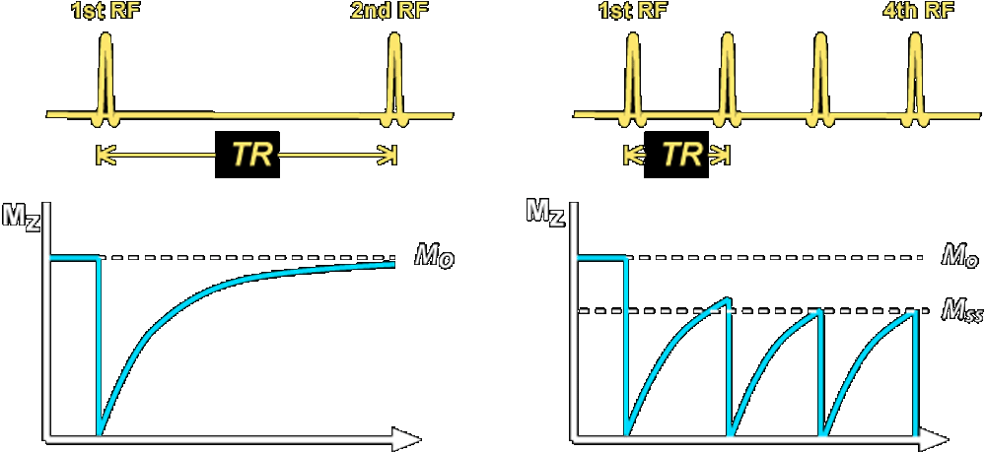
What is a Steady-State Signal?
Rapid & Periodic RF
Balance Between Excitation and Relaxation
Time to reach Steady-State
Signal Dependence on T1, T2, TR & Flip angle
(< 90⁰ for higher overall signal)
Figure 3. Steady State Magnetization [b]
Notes:
One of the main characteristics of bSFFP i.e A steady-state signal is achieved when the longitudinal magnetization does not fully relax between repeated RF pulses.
But for this to occur, certain conditions must be met, like a short TR i.e. rapid and repeated RF pulses.
When the energy added by the RF pulses balances the energy lost through T1 and T2 relaxation processes, this state is achieved.
However, it typically takes 5–10 TR cycles to fully stabilize.
The intensity of this steady-state signal depends on factors like the tissue properties T1 and T2, sequence parameters such as TR and flip angle, and the effects of off-resonance frequencies.
This steady-state magnetization is what enhances the signal strength and minimizes artifacts for a bssfp signal.

Slide 4

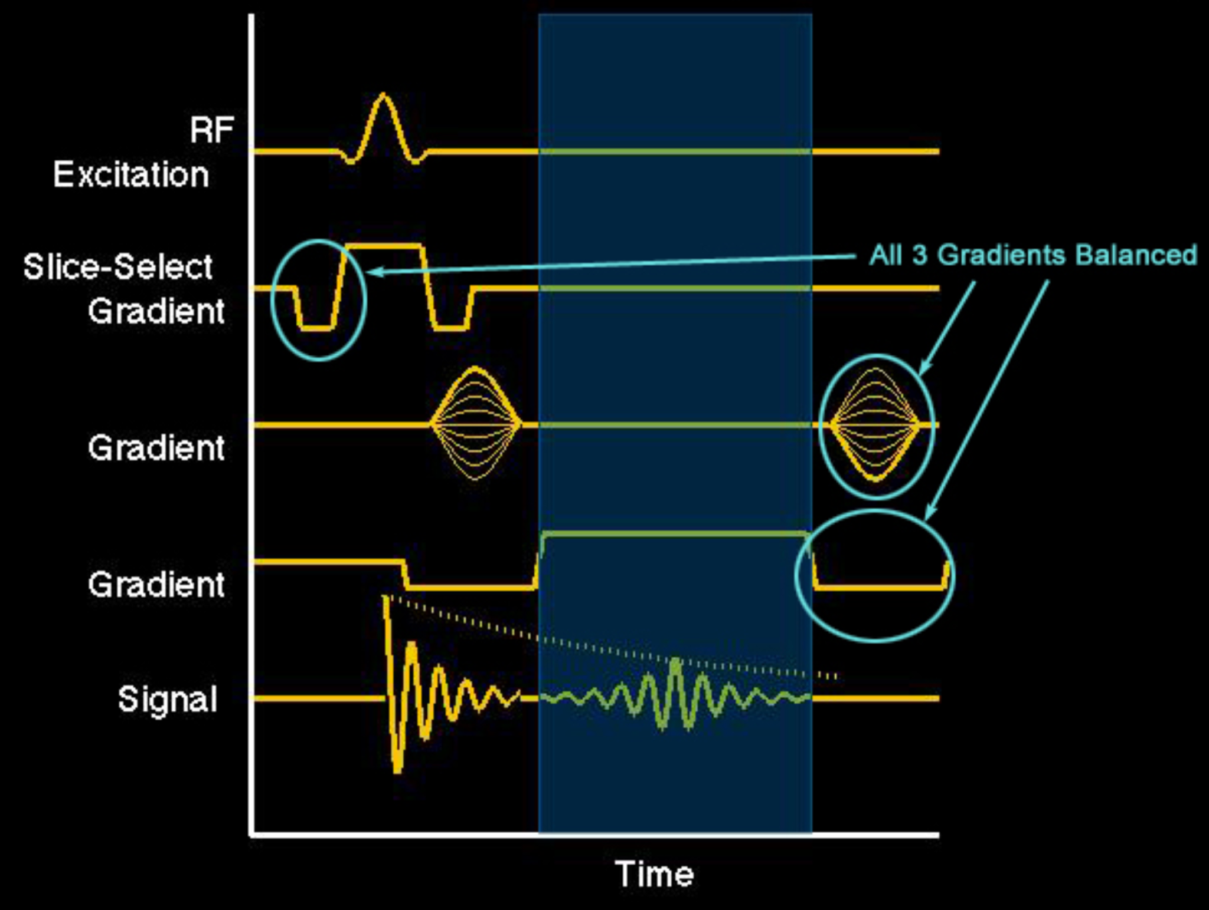
What are Balanced Gradients?
+ve & -ve Gradient Lobes cancel out over TR
Across all 3 axes: slice-selection, phase encoding, frequency encoding
Refocus dephasing caused by gradient fields
Preserving coherent transverse magnetization across successive TRs
Figure 4. Balanced Gradients [c]
Notes:
Another critical feature of bSSFP are the balanced gradients. They ensure that the net effect of the gradient fields applied during one TR cycle cancels out completely.
This means that if you were to sum up the gradient effects—whether for slice selection, phase encoding, or frequency encoding—they would add up to zero.
Why is this important? Without balancing, gradient fields can cause the spins to dephase, leading to signal loss and artifacts.
But by applying these equal and opposite gradient lobes, during each TR cycle, we can refocus the magnetization and maintain its coherence.
This is essential for achieving the high signal intensity and the characteristic T2/T1 contrast of bSSFP.
As you can see in the diagram, the gradient waveform has equal positive and negative lobes, perfectly balancing out by the end of the cycle.

Slide 5
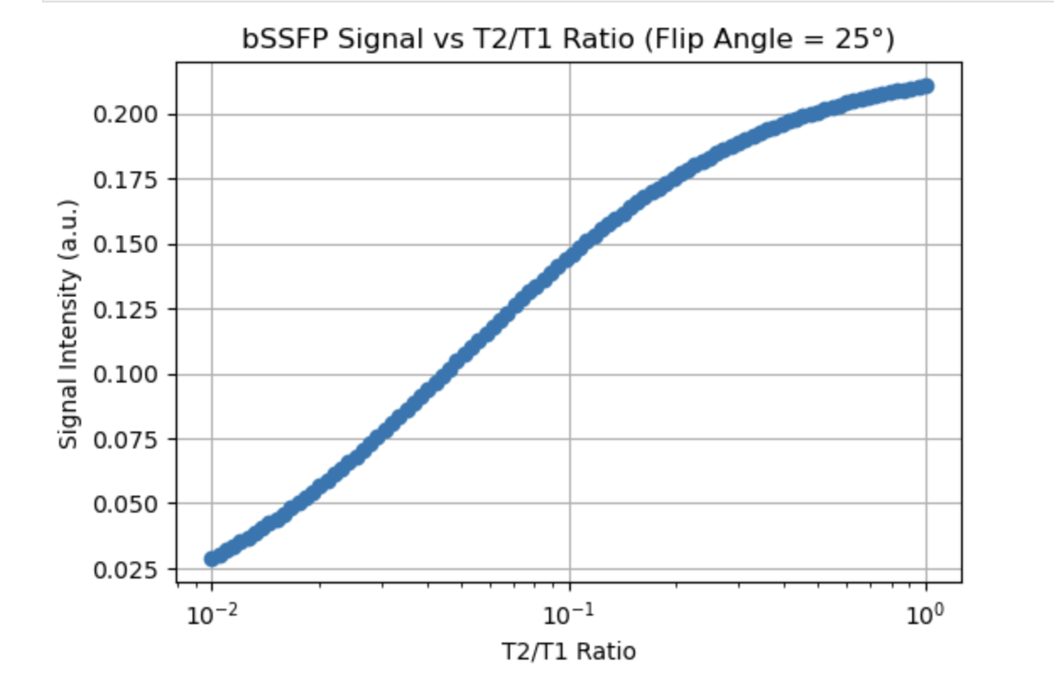
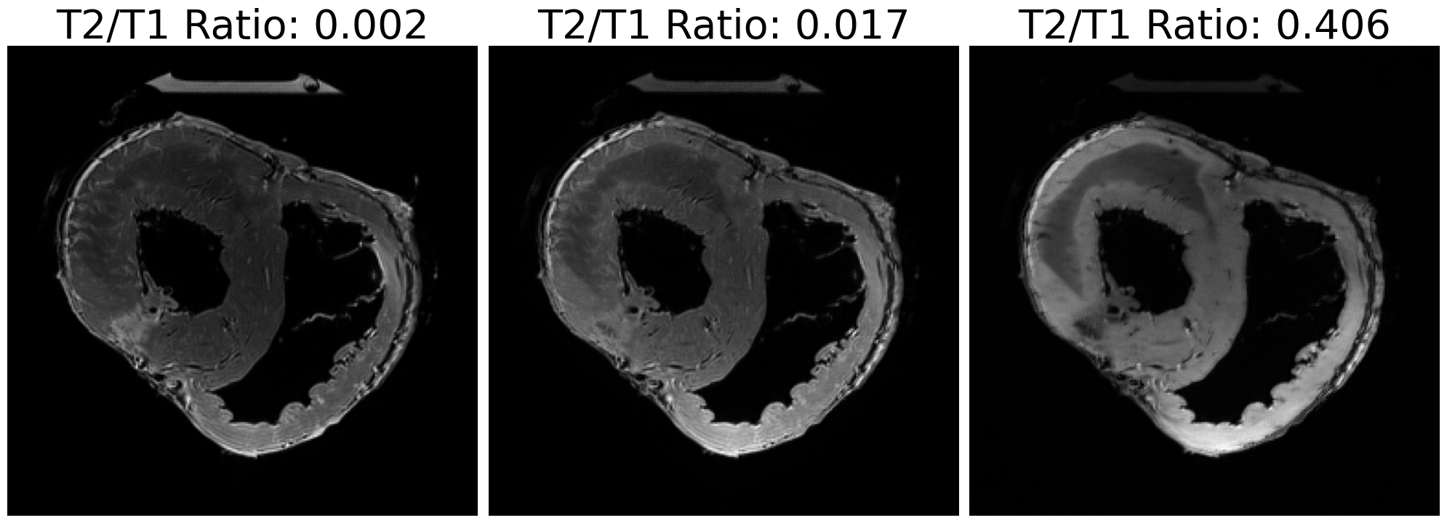
Effects of T2/T1 Ratio on Signal Strength
bSSFP signal is proportional to the T2/T1 ratio of tissues
Higher ratio = better contrast
Strong and stable signal with high SNR
Table 1. T2/T1 for different tissues [3]
Tissue | T2/T1
Arterial Blood | 0.21
Fat | 0.3
Muscle | 0.05
Generated as part of our simulation
Notes:
Unlike standard gradient-echo or spin-echo sequences, bSSFP contrast depends on the ratio of T2 to T1.
Tissues with a high T2/T1 ratio have a high steady-state signal and appear brighter.
And, those with shorter T2 compared to T1 appear darker.
Another aspect here is, you can achieve high signal from blood even without relying on fresh inflow of unsaturated spins (a mechanism that is often used in gradient-echo angiography).
Because the sequence maintains a steady state of transverse magnetization,
even the stationary blood spins are bright, making it easier to visualize cardiovascular structures in dynamic “cine” acquisitions.

Slide 6
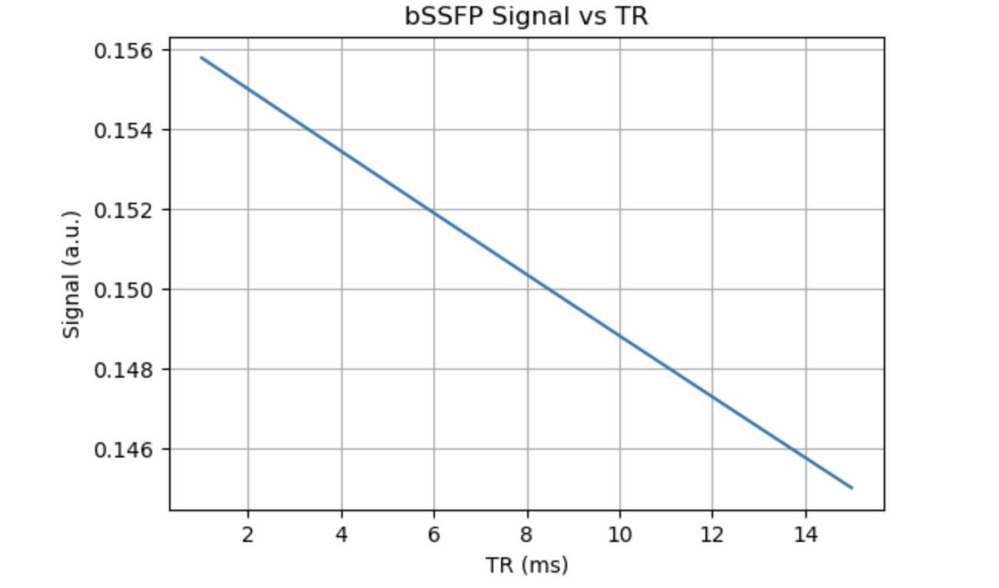
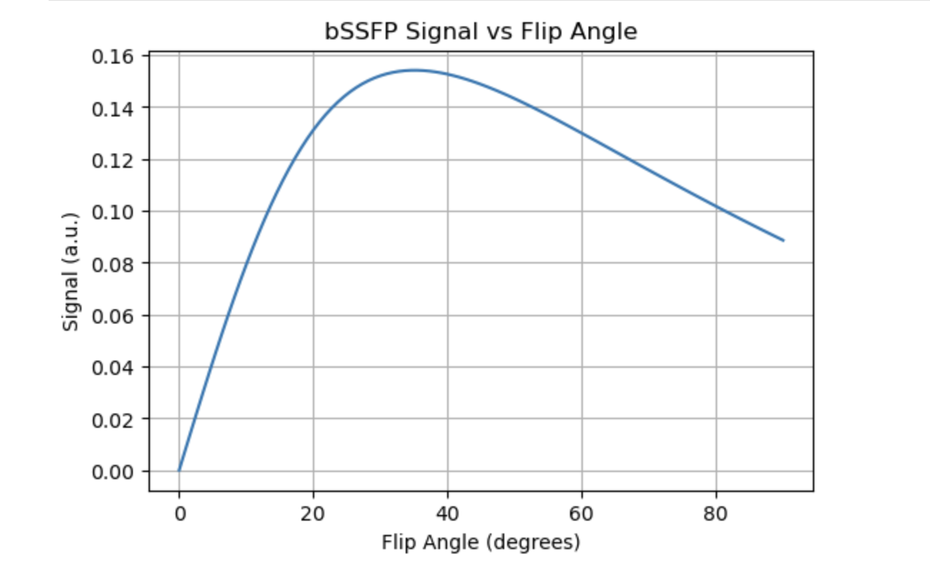
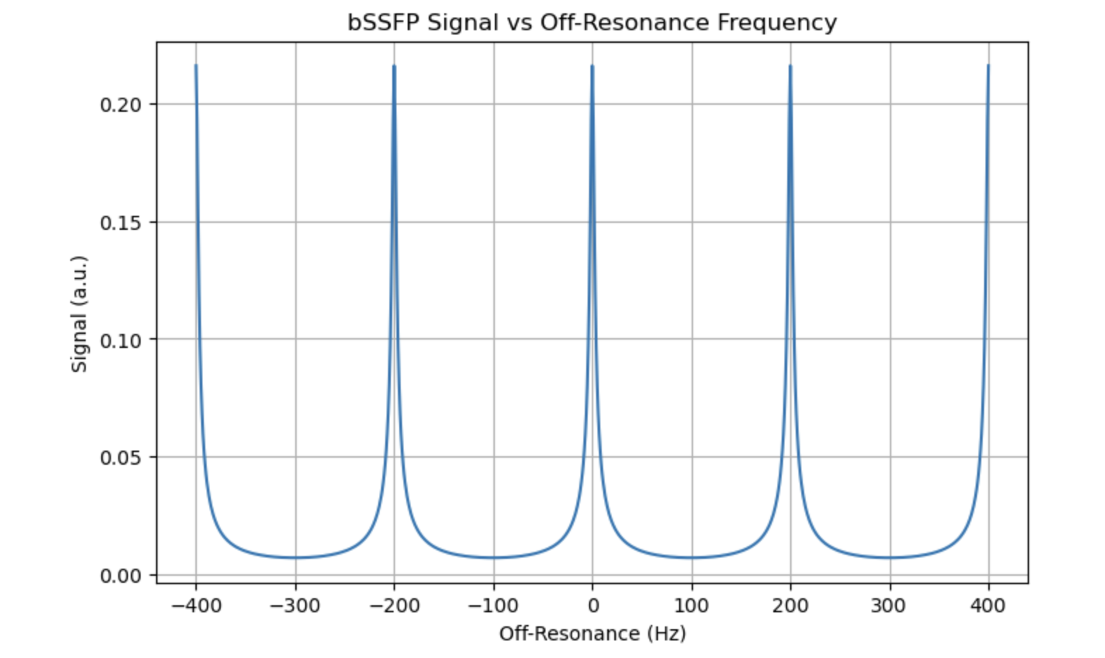
Dependence of bSSFP on Imaging Parameters
Repetition Time (TR): Determines banding artifact frequency.
Flip Angle: Affects signal intensity and contrast.
Off-Resonance: Influences artifact visibility and band placement.
Generated as part of our simulation
Notes:
Let’s see how different imaging parameters are important for bssfp, With a longer TR, spins have more time for T2 decay before the next RF pulse, so this extra decay reduces the steady-state signal. Although this impact of TR also depends on T1, T2, and flip angle: if T2 is long and TR increases slightly, the signal change is minimal. Similarly, Low flip angles generate little transverse magnetization, resulting in weak signals. Increasing the angle boosts signal by converting more longitudinal magnetization to transverse. But Beyond a certain point, over-tipping leads to partial saturation and reduces the signal due to insufficient recovery of longitudinal magnetization. Another important phenomenon is the off-resonance effects. These are caused by spins precessing at frequencies different from the RF pulse (for e.g., due to magnetic field inhomogeneities), This significantly affects the steady-state signal value as well as tissue contrasts in bSSFP sequences.

Slide 7
Simulation
Notes:
Now we will go over our simulations

Slide 8
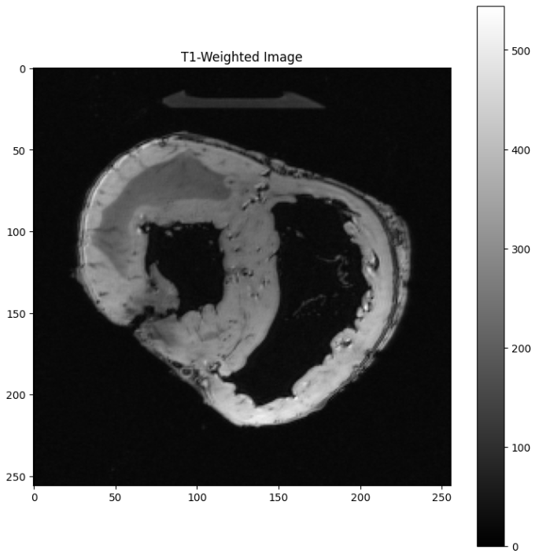
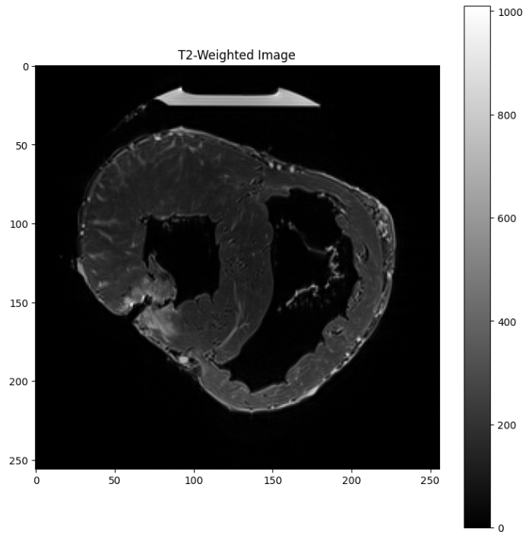
Dataset and Known Imaging Parameters
Ex Vivo Porcine Heart DT MRI Dataset [1] - Stanford CMR group
Imaging system: Siemens Magnetom Prisma fit → 3T scanner
T1 protocol: FLASH 3D
T2 protocol: TSE 3D
Number of slices: 240
Repetition Time: 12 ms
Echo Time: 3.15 ms
Flip Angle: 25°
Visualization of our dataset
Notes:
We used the Ex Vivo Porcine Heart Dataset from the Stanford CMR group, which has an inherently high SNR because it was captured using a 3T scanner
T1 images were captured using the Fast Low Angle SHot or FLASH protocol and highlight tissue structures as seen in the left image.
T2 images were captured using Turbo-spin-Echo or TSE protocol and emphasize water content and tissue composition.
The dataset also contains imaging parameters such as repetition time and flip angle, which we used for our simulation.

Slide 9


Modeling Steady-State Magnetization
Bloch equations show the evolution of magnetization over time
We can simplify this by assuming Bx, By and Bz = 0
M_{i} = Magnetization along the i axis, i ∈ {x,y,z}
B_{i} = External magnetic field components along the i axis, i ∈ {x,y,z}
M₀ = Equilibrium Magnetization
T1 = Longitudinal Relaxation Time
T2 = Transverse Relaxation Time
Notes:
We started off with the Bloch equations, which describe how the magnetization vector evolves over time in the presence of a magnetic field
To make the Bloch equations more manageable, we simplified them by assuming that the external magnetic field components along x,y and z directions are zero.

Slide 10



Modeling Steady-State Magnetization
RF pulses rotate the magnetization by the flip angle α
If this is repeated every TR → Magnetizations stabilize
Relaxation equation | Steady-state equation
Notes:
Next we looked into the modeling of steady-state magnetization under the influence of RF pulses.
RF pulses rotate the magnetization vector by a specified flip angle, denoted by alpha.
The transverse components Mx and My are reset based on this flip angle and the longitudinal component Mz is reduced based on flip angle, but recovers during relaxation
When these pulses are repeated at regular intervals, known as the repetition time or TR, the magnetization reaches a stabilized, steady-state condition.

Slide 11


Modeling Steady-State Magnetization
Combine the 3 steady-state equations into the full steady-state magnetization
Consider the magnitude of this magnetization [2]
where
Notes:
Finally, we consolidated the axis-wise equations into a single expression that fully describes the steady-state magnetization
The combined equation takes into account the contributions from both the longitudinal and transverse components. The imaginary component i accounts for the phase relationship between the RF pulse and the transverse magnetization.
To simplify our analysis, we focused on only the magnitude of the steady-state magnetization.
So far we have only derived the on-resonance equation, which acts as the baseline signal for our simulation. We will model the signal degradation caused by off-resonance effects in an upcoming step

Slide 12
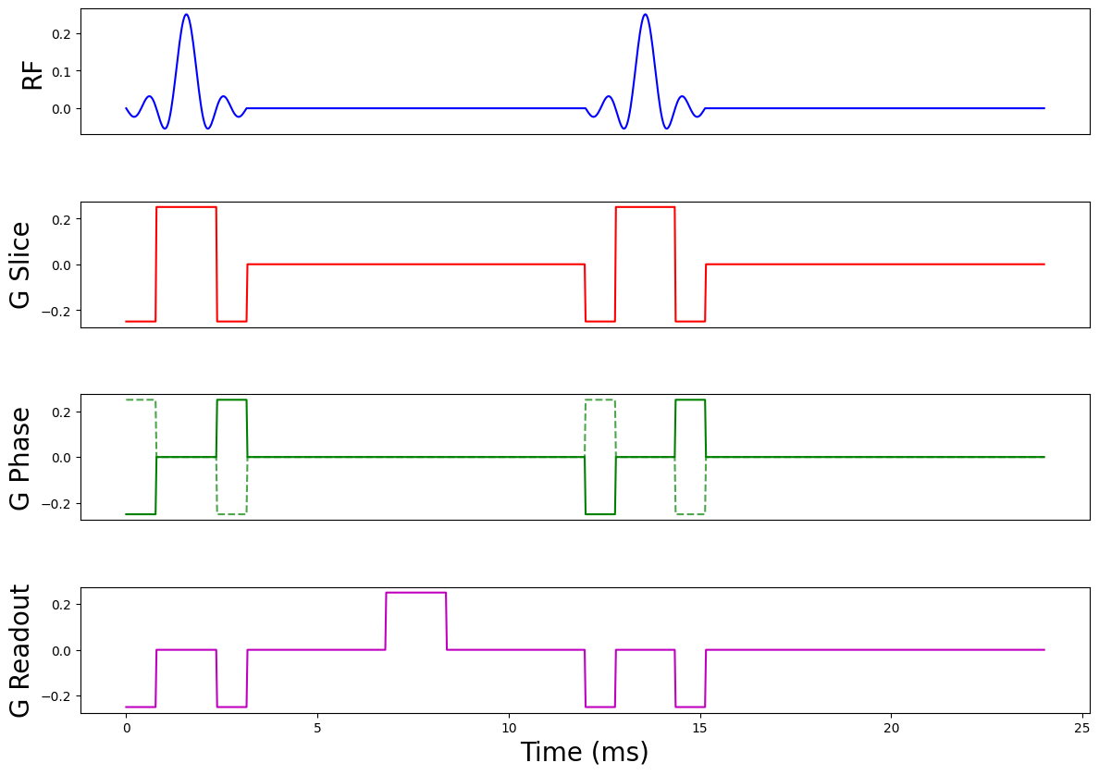
TR
Generated as part of our simulation
Notes:
We can spatially encode Mss into an image using three key gradients: Gslice, Gphase and Greadout​.
The slice-selection gradient, applied along the z-axis during the RF pulse, excites spins in a specific frequency range, restricting Mss​ to the desired slice.
The phase-encoding gradient along the y-axis introduces position-dependent phase shifts, enabling spatial encoding of Mss​ across cycles.
The readout gradient along the x-axis creates frequency shifts in the transverse magnetization, producing a spectrum that maps the spatial distribution of Mss
As Sharvari mentioned earlier, each gradient must be balanced, meaning the net area under each gradient waveform must be zero over one TR. Our gradients do meet this requirement.

Slide 13


Modeling Off-resonance Effects
Generate off-resonance frequency map (Δf)
Phase accumulation across voxels
where TR is in seconds
bSSFP signal modification
→
Notes:
Off-resonance frequencies were uniformly distributed between −100 and 100 Hz, simulating magnetic field variations from inhomogeneities or tissue susceptibility differences.
Then we calculated the phase accumulation phi across voxels, which is proportional to the off-resonance frequency and repetition time.
Finally, we modified the bssfp steady-state signal S by introducing an additional phase term that accounts for the accumulated phase shift.
We expect to see banding artifacts in the acquired signals after incorporating these off-resonance effects
https://ece-classes.usc.edu/ee591/library/Scheffler-Pictoral%20Description%20of%20Steady%20States.pdf

Slide 14
Assumptions/Modifications for the Simulation
Synthetic T1 and T2 map generation
Synthetic T1 range: 250-1500 ms
Synthetic T2 range: 40-200 ms
Maps do not consider tissue-specific T1 & T2 scaling
Uniform, linear scaling for all tissues
M₀ does not reflect true proton density distribution
M₀ = unscaled T1 image
Off-resonance effect is modeled uniformly across all tissues
Dynamic effects (heart beating and breathing) are also ignored
Notes:
To effectively simulate bssfp using the available data, we made some assumptions and modifications.
We generated synthetic T1 and T2 maps by linearly rescaling raw images using typical relaxation times for porcine cardiac tissues. While this simplified the model, it also reduced physiological variability and tissue contrast information.
M0​, which represents the equilibrium magnetization, is set as an unscaled T1 image. This assumption was made because we did not have the true proton density distribution of tissues.
Finally, the off-resonance effects are modeled uniformly across all tissues, assuming consistent frequency shifts for the entire field. Dynamic effects such as heart beating or breathing are excluded, which could otherwise introduce temporal variations in the off-resonance profile.

Slide 15
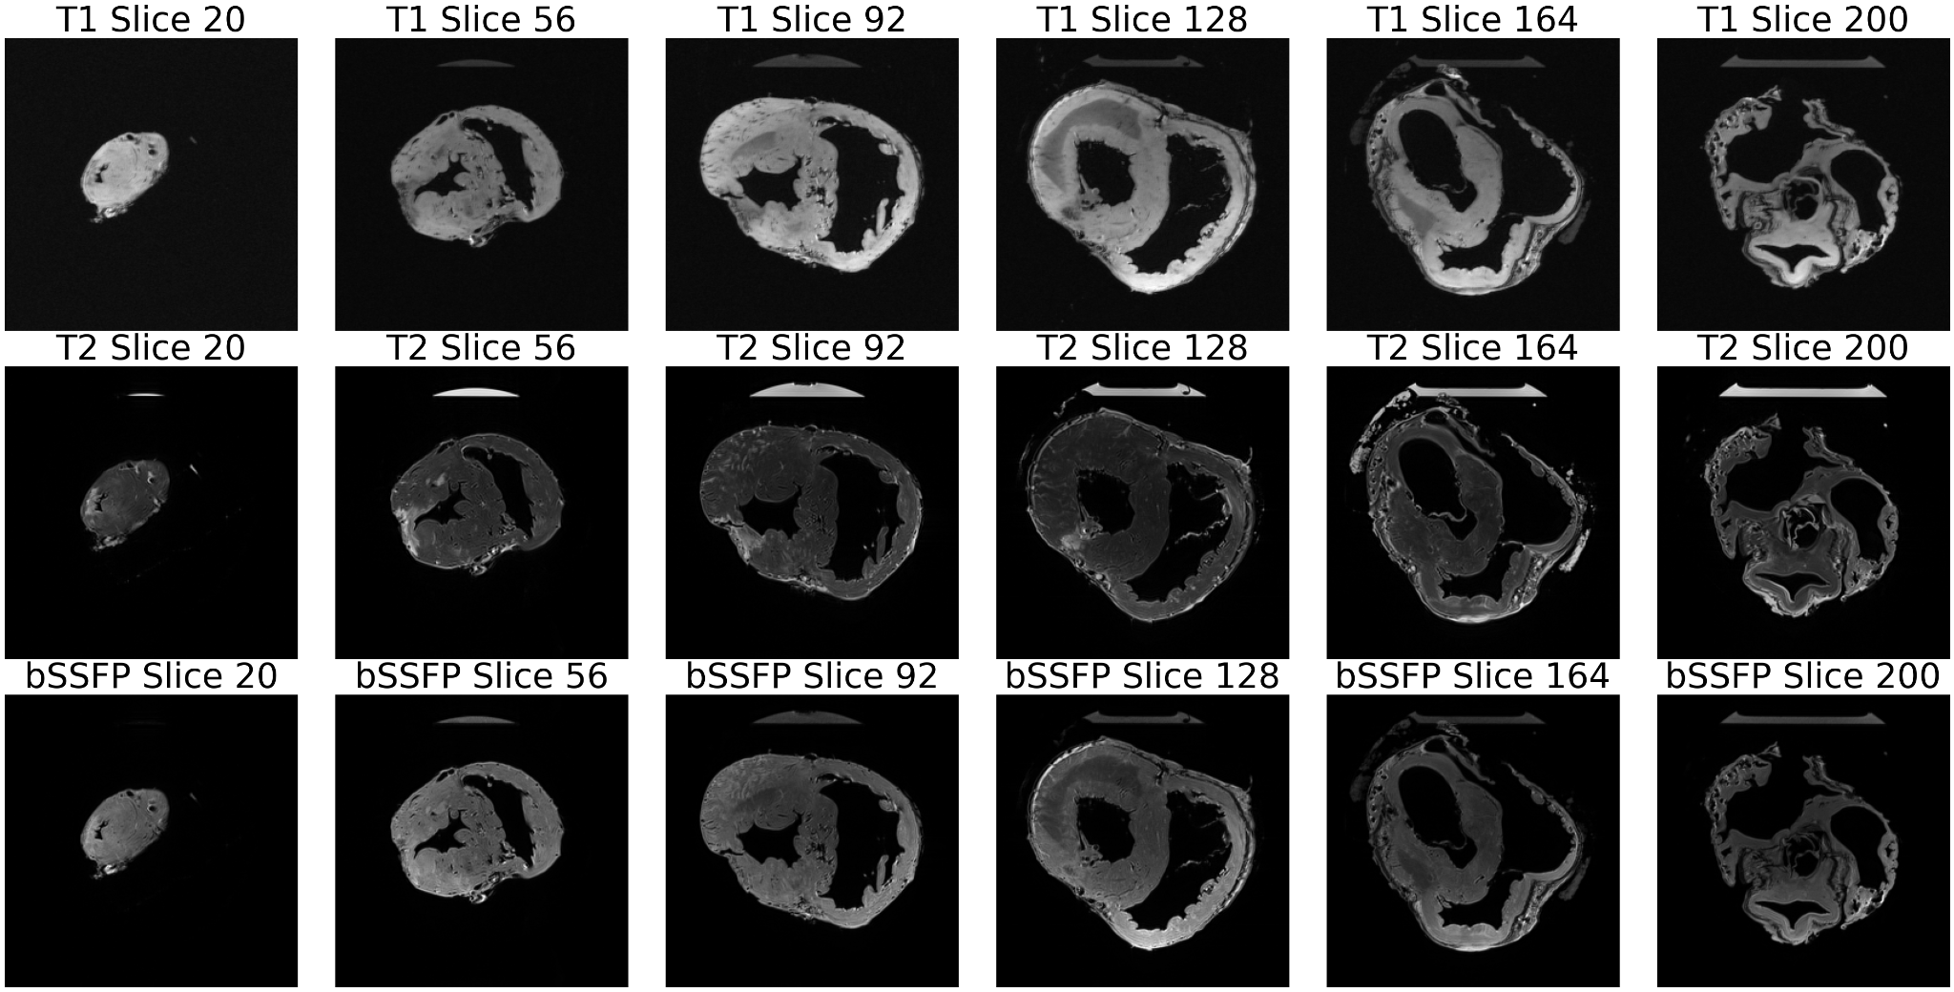
Results: Images after bSSFP
Visualization of our results
Notes:
Here are our image outputs after the bssfp simulation, compared with the coregistered T1 and T2 images. The output from bSSFP shows a distinctive blend of T1 and T2 weighting. Compared to pure T1 or T2 images, blood vessels also appear more prominent in the bssfp image.

Slide 16
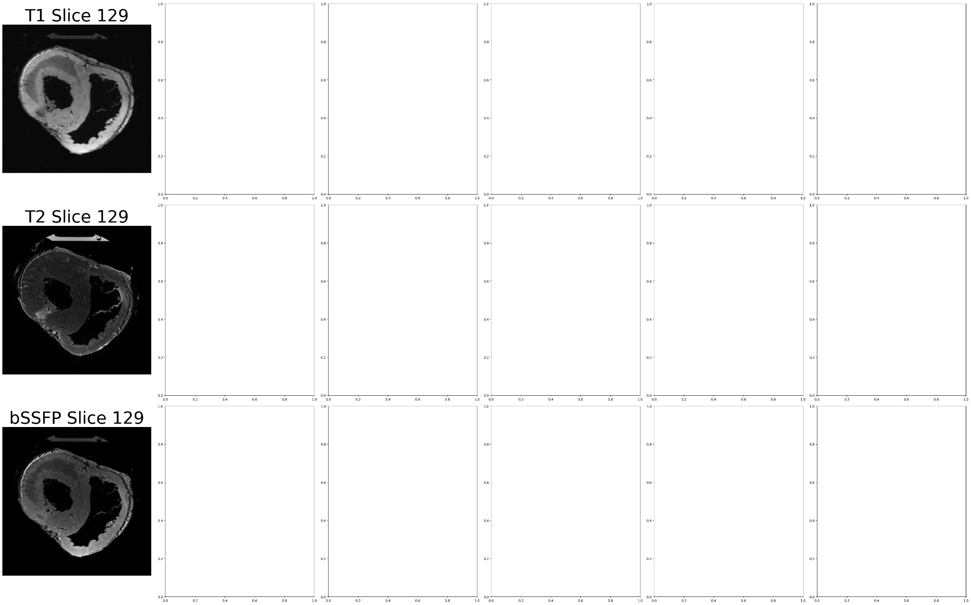
Results: Images after bSSFP
Visualization of our results
Notes:
Here are our image outputs after the bssfp simulation, compared with the coregistered T1 and T2 images. The output from bSSFP shows a distinctive blend of T1 and T2 weighting. Compared to pure T1 or T2 images, blood vessels also appear more prominent in the bssfp image.

Slide 17
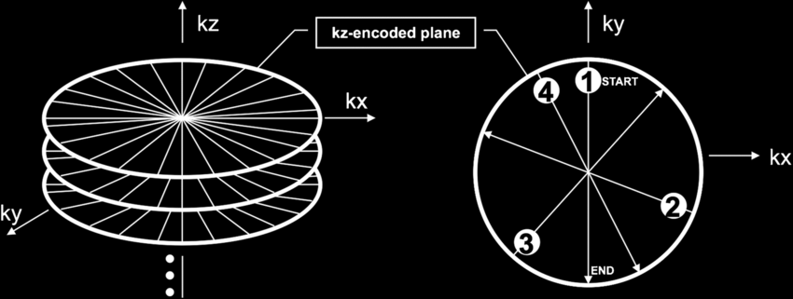
Stack-of-Stars (SoS) K-space Sampling
Golden-angle radial sampling in xy plane + Cartesian sampling along z axis [5]
Fig 5. Illustration of 3D k-space “stack of stars” trajectory
Notes:
We used a Stack of stars k-space sampling approach. Here, the trajectory samples k-space radially in the in-plane dimensions (x-y) and uses a Cartesian sampling in the through-plane (z) direction.
You end up with a set of radial “spokes” in each 2D plane, stacked along the third dimension. TRANSITION SLIDE AFTER THIS SENTENCE
Each radial spoke samples k-space from the center (low spatial frequency) outwards. By rotating the spokes around the center, different angles in k-space are covered.
the number of spokes determines your angular sampling density. A common rule of thumb for full sampling in a purely radial 2D acquisition is: (eqn)
where FOV is the field-of-view and Δx is the desired spatial resolution (voxel size). This ensures that the angular increment is fine enough to meet Nyquist along all directions.

Slide 18
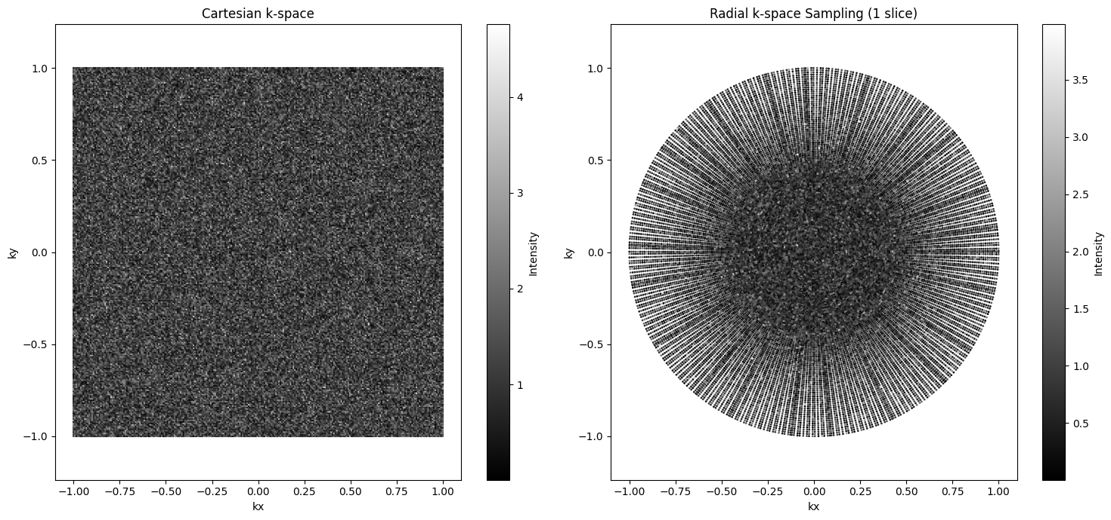
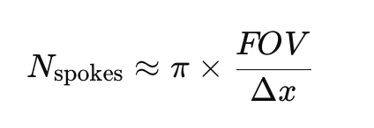
Stack-of-Stars (SoS) K-space Sampling
Golden-angle radial sampling in xy plane + Cartesian sampling along z axis [5]
Number of spokes = 400, Golden angle = 112.5° [6]
Generated as part of our simulation
Notes:
We used a Stack of stars k-space sampling approach. Here, the trajectory samples k-space radially in the in-plane dimensions (x-y) and uses a Cartesian sampling in the through-plane (z) direction.
You end up with a set of radial “spokes” in each 2D plane, stacked along the third dimension. TRANSITION SLIDE AFTER THIS SENTENCE
Each radial spoke samples k-space from the center (low spatial frequency) outwards. By rotating the spokes around the center, different angles in k-space are covered.
the number of spokes determines your angular sampling density. A common rule of thumb for full sampling in a purely radial 2D acquisition is: (eqn)
where FOV is the field-of-view and Δx is the desired spatial resolution (voxel size). This ensures that the angular increment is fine enough to meet Nyquist along all directions.

Slide 19
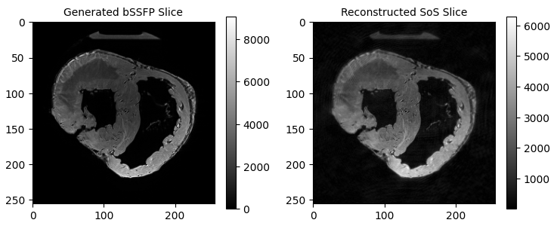
Results: Reconstruction of the SoS Sampled Image
Reconstruction method: Inverse Fourier Transform of K-space image
Visualization of our results
Notes:
Our recon method was the inverse fourier transform.
Because the in-plane data is acquired along radial spokes rather than a Cartesian grid, you can’t simply apply a standard inverse FFT directly. Instead, a common approach is to use Gridding: Interpolate the non-Cartesian (radial) data onto a uniform Cartesian grid in k-space using a “gridding” kernel. After gridding, the data approximates what you would have obtained with Cartesian sampling.
Once the radial data is regridded onto a Cartesian matrix, apply a standard 2D inverse FFT along the in-plane directions. For the “stack” direction (if it’s Cartesian), a standard 1D IFFT is also performed. The end result is a 3D volume (or multiple 2D slices) in image space.

Slide 20
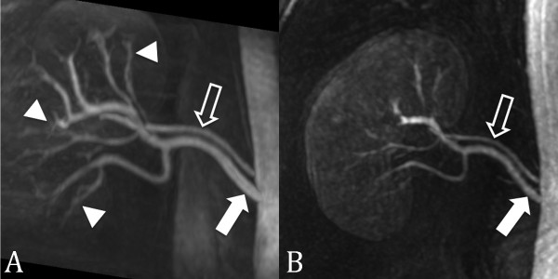
Strengths of bSSFP
High SNR Efficiency
Unique Contrast Characteristics
No Contrast Agents Needed
Fast imaging Capabilities
Good Depiction of Blood vessel and Fluid Visualizations
Used for functional cardiac imaging, cerebrospinal fluid flow
Fig 6. Non-contrast-enhanced SSFP MRA (left) contrast-enhanced MRA (right) [d]
Notes:
The benefits of BSSFP include:
High SNR:
You achieve a steady-state of magnetization, allowing it to generate strong transverse signal.
Second, unique Contrast characteristics: Intrinsically you get “bright blood” contrast without any contrast agents.
Sensitive to T2/T1 ratios, making fluid and blood-filled structures appear bright.
Third, Fast imaging: Short TR enables fast acquisition.
Ideal for dynamic, real-time imaging scenarios (e.g., cardiac cine studies)
Lastly, Good Depiction of blood vessels
Used for functional cardiac imaging and CSF

Slide 21
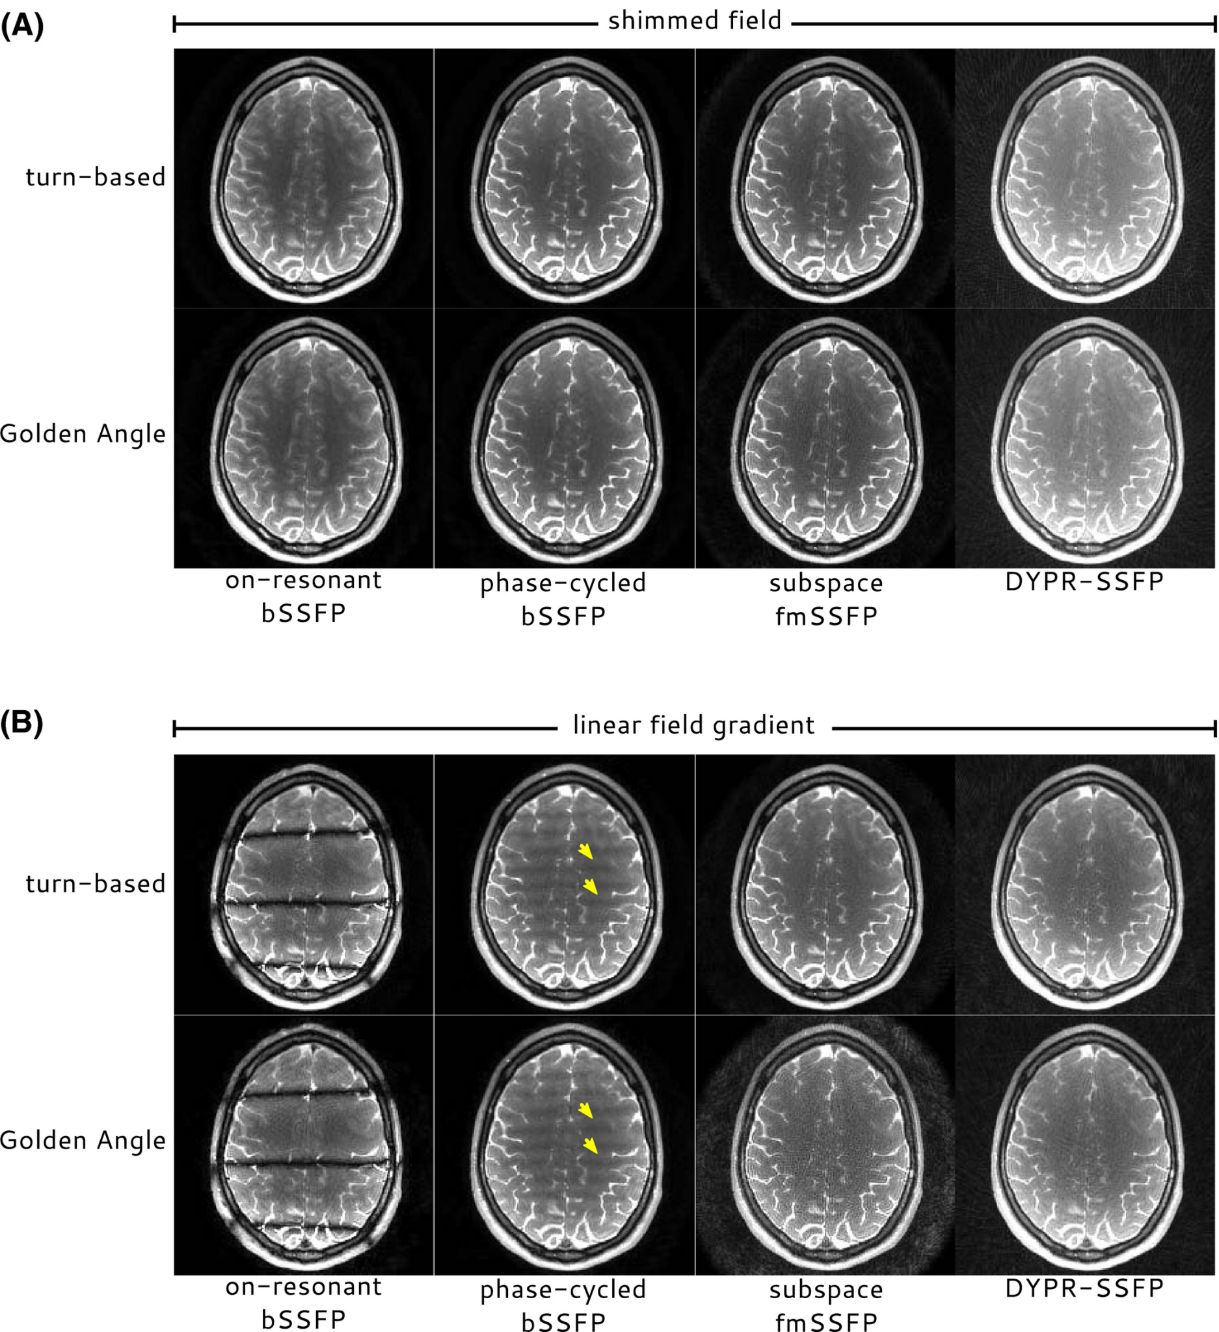
Challenges in bSSFP
Susceptibility to Off-Resonance Effects:
Banding Artifacts
Field Inhomogeneity Sensitivity
Can do phase cycling to mitigate
B1 Inhomogeneity and Flip Angle Variations:
Non-Uniform Flip Angles
Need to do advanced shimming
Fig 7. Without shimmed field (top) and with shimmed field (bottom) [e]
Notes:
Given that, there are a few challenges. The off-resonance effects are a main one. When spins are off-resonance, they accumulate additional phase from one TR to the next, shifting them out of the ideal steady-state condition. It basically causes the Larmor frequency of spins to deviate slightly from the nominal resonance frequency.
Because of this, you end up with Banding Artifacts: Even small off-resonance frequencies can lead to destructive interference of the steady-state signal and produce distinct dark “bands” across the image. Shown in the figure Second, the Imperfections in B0 homogeneity, as well as local susceptibility differences (e.g., at air-tissue interfaces), worsen off-resonance issues.
We can use Phase Cycling to mitigate, Where Modifying the RF phase increment between excitations shifts the banding patterns. Combining these images can average out artifacts.
B1 Inhomogeneities and Flip Angle Variations are another challenge, bSSFP relies on consistent flip angles to maintain a stable steady-state. Variations in the transmitted RF field (B1+) can distort flip angles Lastly, the need for Shim Optimization: By adjusting small magnetic field gradients or adding shim coils and materials, you can reduce local variations in the main magnetic field

Slide 22
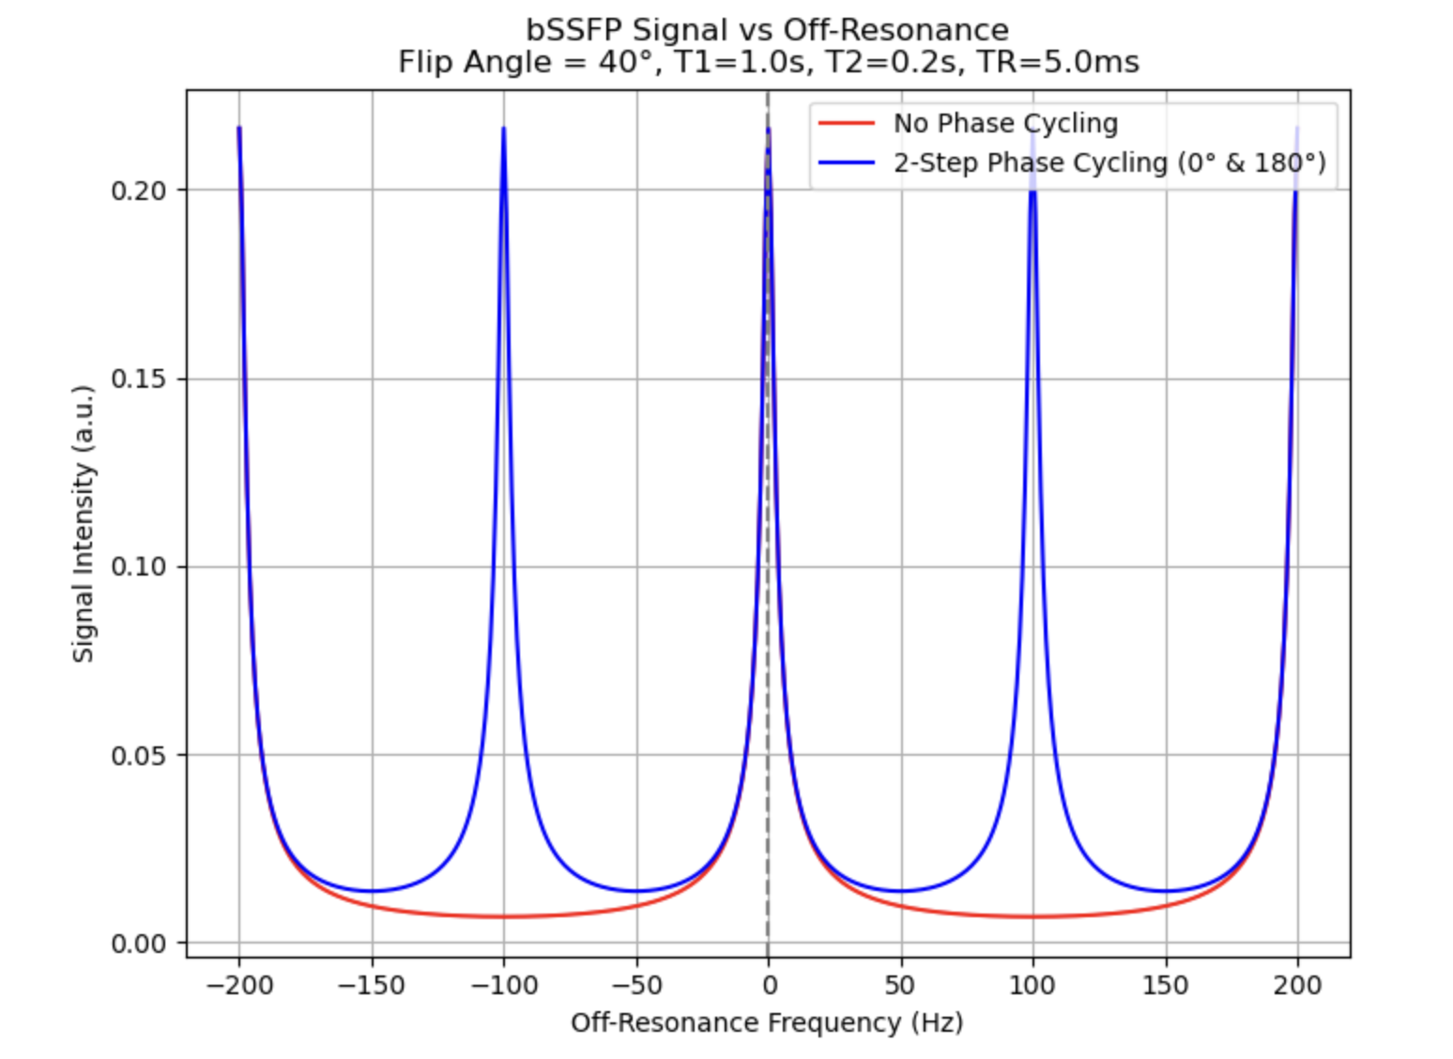
Off-Resonance Effects and Phase Cycling
Series of RF pulse phases that differ by specific increments (usually 90° or 180°) between successive RF pulses in the sequence. → Dephase the signal that contribute to artifacts
Generated as part of our simulation
Notes:
Phase cycling involves applying a series of RF pulse phases that differ by specific increments (usually 90° or 180°) between successive RF pulses in the sequence. → Dephase the signal that contribute to artifacts. This technique works by averaging out these artifacts across multiple cycles, with the final image being the sum of the signals from all the cycles.
Without Phase Cycling: The red curve (no phase cycling) should show a central peak near 0 Hz off-resonance, but also multiple nulls (deep dips) away from zero—these represent the banding frequencies.
With Phase Cycling: The blue curve (2-step phase cycling) typically shows fewer deep nulls. While not entirely band-free, the sum-of-squares combination of the two acquisitions reduces the severity of the minima, showing how phase cycling mitigates banding artifacts.

Slide 23
References
[1] Ex Vivo Porcine Heart DT MRI Dataset
Accessed from: https://med.stanford.edu/cmrgroup/data/ex_vivo_dt_mri.html Accessed on: 11/19/2024
[2] Bieri, Oliver, and Klaus Scheffler. "Fundamentals of balanced steady state free precession MRI." Journal of Magnetic Resonance Imaging 38.1 (2013): 2-11.
[3] https://mriquestions.com/ssfp-mra.html#/
[4] Feng, Xue et al. “Non-Cartesian balanced steady-state free precession pulse sequences for real-time cardiac MRI.” Magnetic resonance in medicine vol. 75,4 (2016): 1546-55. doi:10.1002/mrm.25738
[5] https://mriquestions.com/k-space-trajectories.html#/
[6] Zhou, Ziwu, et al. "Golden‐ratio rotated stack‐of‐stars acquisition for improved volumetric MRI." Magnetic resonance in medicine 78.6 (2017): 2290-2298.
Notes:
This is our references for our content and materials

Slide 24
Images
Our Code
https://github.com/186shades/mri-bSSFP-simulation
[a] https://radiopaedia.org/articles/gradient-echo-sequences-1?lang=us
[b] https://mriquestions.com/how-is-signal-higher.html#/
[c] Overview of MRI Pulse Sequences and Image Acquisition - N. Yanasak, PhD Department of Radiology and Imaging Augusta University - https://amos3.aapm.org/abstracts/pdf/127-35665-418554-127775-1650906372.pdf
[d] Hartung, Michael P., Thomas M. Grist, and Christopher J. François. "Magnetic resonance angiography: current status and future directions." Journal of Cardiovascular Magnetic Resonance 13.1 (2011): 19.
[e] Roeloffs, Volkert, et al. "Frequency‐modulated SSFP with radial sampling and subspace reconstruction: A time‐efficient alternative to phase‐cycled bSSFP." Magnetic Resonance in Medicine 81.3 (2019): 1566-1579.
[f] Hu, Houchun H., et al. "Post-contrast T1-weighted spine 3T MRI in children using a golden-angle radial acquisition." Neuroradiology 61 (2019): 341-349.
https://github.com/186shades/mri-bSSFP-simulation
Notes:
Next is our references for our images and our code

Slide 25

THANK YOU!

